Slide 1
Data Analysis For Hotel Bookings
Presented By : Bhavesh Bhagat

Slide 2
Problem Statement
In recent years, City Hotel and Resort Hotel have seen high cancellation rates. Each hotel is now dealing with a number of issues as a result, including fewer revenues and less than ideal hotel room use. Consequently , lowering cancellation rates is both hotels primary goal in order to increase their efficiency in generating revenue, and for us to offer thorough business advice to address this problem.

Slide 3
Research Question
What are the variables that affect hotel reservation cancellations ?
How can we make hotel reservations cancellations better ?
How will hotels be assisted in making pricing and promotionals decisions?

Slide 4
Hypothesis
More cancellations occur when prices are higher.
The majority of clients are coming from offline travel agents to make their reservations.

Slide 5
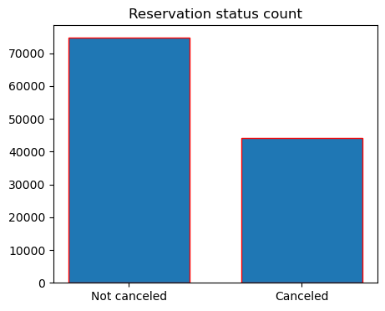
Analysis and Findings
This bar graph shows the percentage of reservations that are canceled and those that are not .

Slide 6
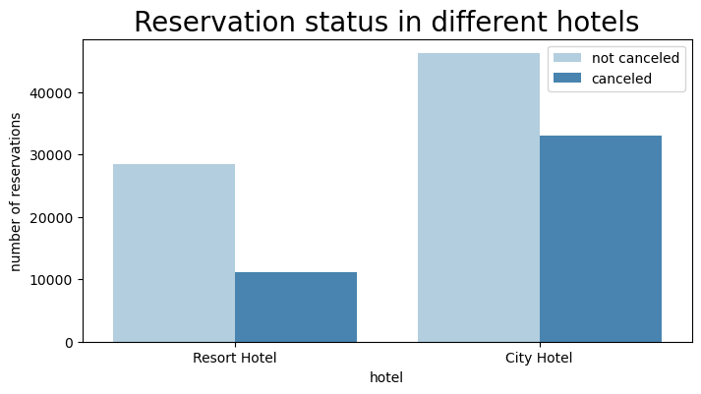
Analysis and Findings
In comparison to resort hotel , city hotels have more bookings. It’s possible that resort hotels are more expensive than city hotels.

Slide 7
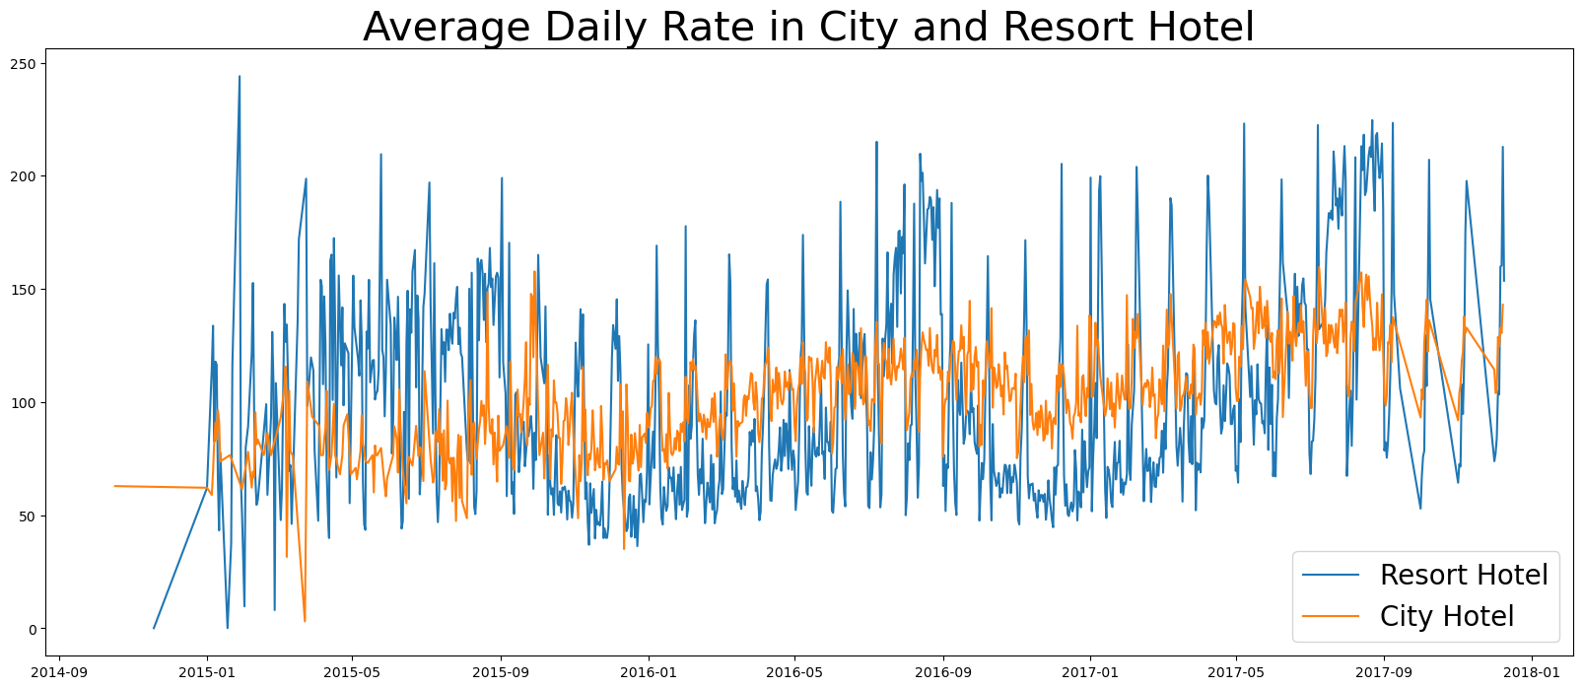
Analysis and Findings
The line graph above shows that, on certain days, the average daily rate for a city hotel is less than that of a resort hotel, and on other days it is even less. Weekends and holidays may see a rise in resort hotel rates.

Slide 8
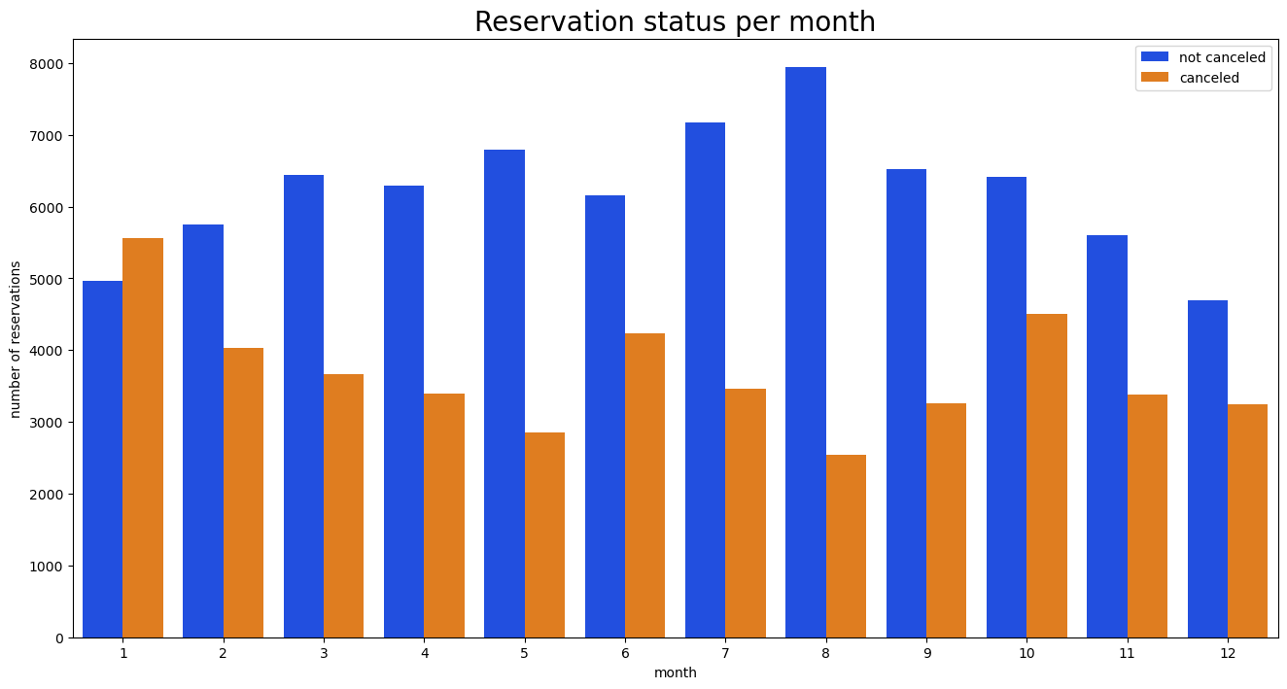
Analysis and Findings
Here we can see that number of confirmed reservations are highest in the month of August. Whereas January is the month with the most canceled reservations

Slide 9
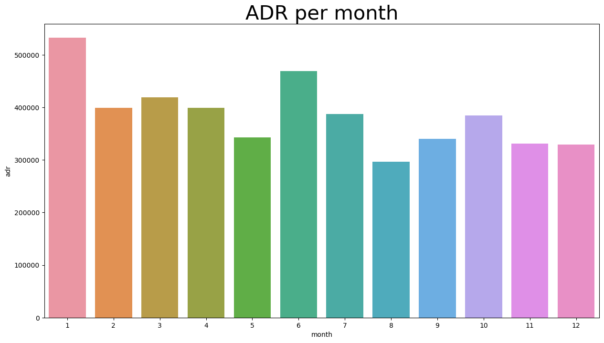
Analysis and Findings
It demonstrate that cancellations are more common when prices are high. Therefore , the cost of the accommodation is solely responsible for cancellation.

Slide 10
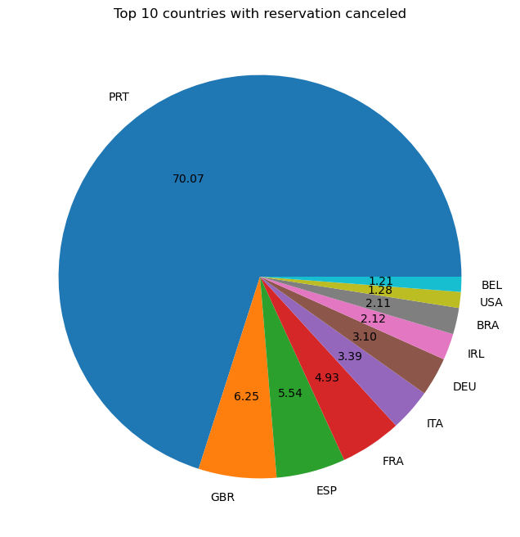
Analysis and Findings
This pie chart shows top 10 country wise cancellation and we can see that Portugal has 70.07 percent cancellation.

Slide 11
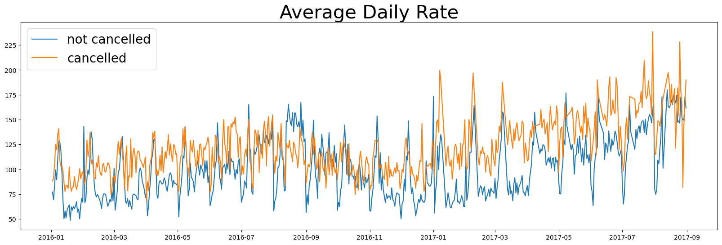
Analysis and Findings
As seen in the graph , reservation are canceled when the ADR is higher than when it is not canceled .

Slide 12
Conclusion
After seeing all the result we can conclude that higher prices leads to higher cancellations.
When the prices is lower it tends to lower cancellations.

Slide 13
Suggestions
Cancellation rates rise as the price does. In order to prevent cancellations of reservations, hotels could work on their pricing strategies and try to lower the rates for specific hotels based on locations. They can also provide some discounts to the consumers.
As the pricing of resort hotel is more . So the hotels should provide a reasonable discount on the room prices on weekends or on holidays.
In the month of January, hotels can start campaigns or marketing with a reasonable amount to increase their revenue as the cancellation is the highest in this month.
They can also increase the quality of their hotels and their services mainly in Portugal to reduce the cancellation rate.

